Slide 1
CIS CONTROL 11: SECURE CONFIG FOR NETWORK DEVICES-II
SECURE CONFIGURATION FOR NETWORK DEVICES SUCH AS FIREWALLS, ROUTERS, AND SWITCHES

Slide 2
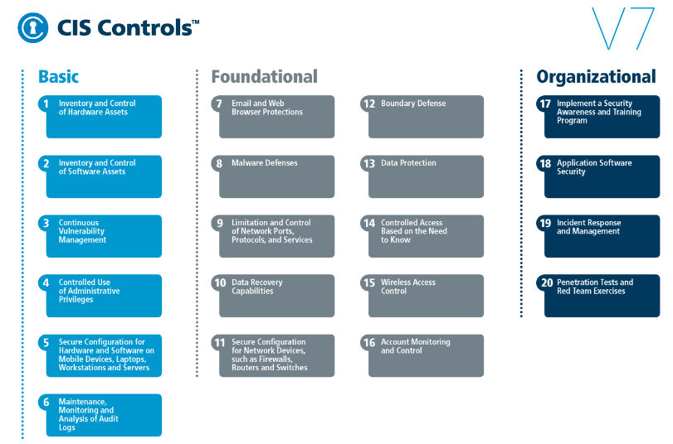
CIS CONTROL 11: SECURE CONFIG FOR NETWORK DEVICES-II
https://www.cisecurity.org/controls/

Slide 3
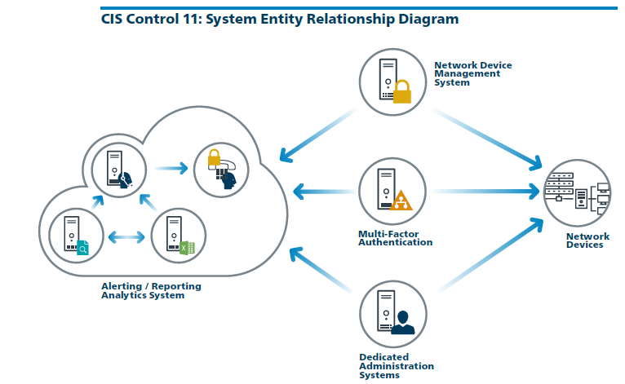
CIS CONTROL 11: SECURE CONFIG FOR NETWORK DEVICES-II
https://www.cisecurity.org/controls/

Slide 4
CIS CONTROL 11: SECURE CONFIG FOR NETWORK DEVICES
11.5: Manage Network Devices Using Multi-Factor Authentication and Encrypted Sessions
Manage all network devices using multi-factor authentication and encrypted sessions.

Slide 5
CIS CONTROL 11: SECURE CONFIG FOR NETWORK DEVICES
11.6: Use Dedicated Machines For All Network Administrative Tasks
Ensure network engineers use a dedicated machine for all administrative tasks or tasks requiring elevated access. This machine shall be segmented from the…

Slide 6
CIS CONTROL 11: SECURE CONFIG FOR NETWORK DEVICES
11.6: Use Dedicated Machines For All Network Administrative Tasks
…organization's primary network and not be allowed Internet access. This machine shall not be used for reading e-mail, composing documents, or surfing the Internet.

Slide 7
CIS CONTROL 11: SECURE CONFIG FOR NETWORK DEVICES
11.7: Manage Network Infrastructure Through a Dedicated Network
Manage the network infrastructure across network connections that are separated from the business use of that network, relying on separate VLANs or, preferably, on entirely different physical…

Slide 8
CIS CONTROL 11: SECURE CONFIG FOR NETWORK DEVICES
11.7: Manage Network Infrastructure Through a Dedicated Network
…connectivity for management sessions for network devices.
END

